Slide 1



Intro to Web Development

Slide 2


Overview
House Rules
Agenda
Introduction of KodeGo
Introduction of Mentees
Introduction to Web Development
Exercises
Notes:
This slide is optional

Slide 3








House Rules
Be On Time.
Sign in at least 5 minutes before the class.
Turn On Camera.
Always turn your camera on so we can see each other.
Mute Your Mic
when you are not talking.
Be prepared.
Avoiding eating during the online session.
Dress Properly
Wear something comfortable but presentable.
Raise Your Hand
If you need help or want to ask something.
Enjoy Learning !

Slide 4
Agenda
Who are you?
Who are we?
WHO
Why are you here?
Why should you finish the course?
WHY
WHAT
What is Web Development?
What are Web Development Stacks?
HOW
How to become a Web Developer?
How to apply what you will learn today?

Slide 5
Introduction of Kodego
Who are you? Intro of Mentor and Assistant
Who are we? About Kodego
WHO
WHY
Why are you here? Course Objective
Why should you finish the course? Benefits and Opportunities

Slide 6
Introduction of Mentees
Who are you? Tell something about yourself in 30 seconds.
Who are we? Think of a Batch name that best describes the class. Type in a chat box.
WHO
WHY
Why are you here? Reasons why you enrolled.
Why should you finish the course? Your motivation to finish the course.

Slide 7
AFFIRMATIONS
I Am a Great Full-stack Developer
I Am Living with a Purpose
I Am a Channel of Blessings

Slide 8
“Do what is easy your life will be hard.
Do what is hard, your life will be easy.”

Slide 9


Slide 10
Learning Outcomes
Soft Skills
Communication Skills
Research
Problem-solving
Interpersonal skills
Technical Skills
Introduction to Web Development
Introduction to Web Stacks
HTML
Web Designing

Slide 11
Soft skills
Communication skills
Cleary state and communicate what you have in mind.
Research
Keep up with the latest news.
Problem Solving
Solving problem and making it all work should be your mindset.
Interpersonal Skills
interacting and communicating with others to help start, build, and sustain relationships.

Slide 12

Introduction to Web Development

Slide 13
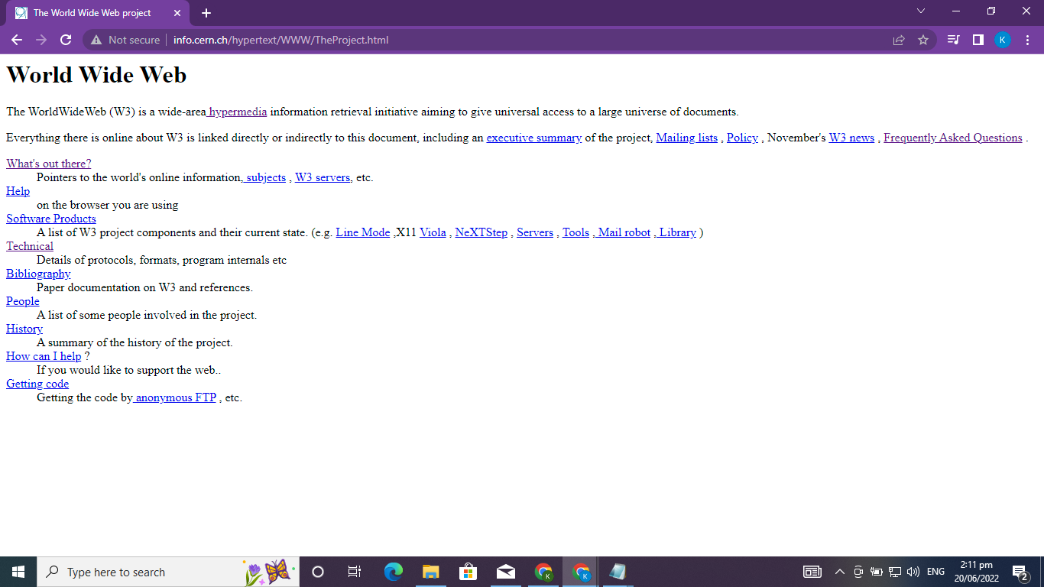
The World’s First Website
Source: http://info.cern.ch/hypertext/WWW/TheProject.html

Slide 14
HOW THE WEB WORKS?
INTERNET
WEB
An international network of connected computers.
It is one set of software services running on the internet.

Slide 15
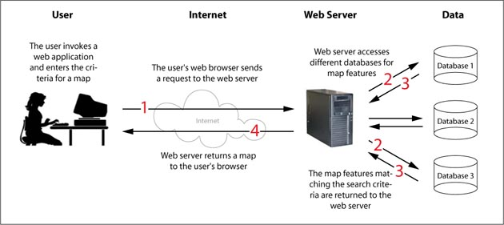
HOW THE WEB WORKS?

Slide 16


SERVER
is the software (not the computer itself).
Web Server - is basically a computer that hosts many websites depending on its capacity.
Application Server - It is a type of server designed to install and operate applications, and hosting the services and applications for end-users, IT services, and organizations.

Slide 17



What is Web Development
BITE, CHEW, SWALLOW and DIGEST the Burger and you can become a FULL-STACK DEVELOPER!
WEB PUBLISHING DATABASE MANAGEMENT
WEB PROGRAMMING WEB DESIGNING
WEB DEVELOPMENT STACK
Stack is set of tools typically used in tandem to develop web apps.

Slide 18
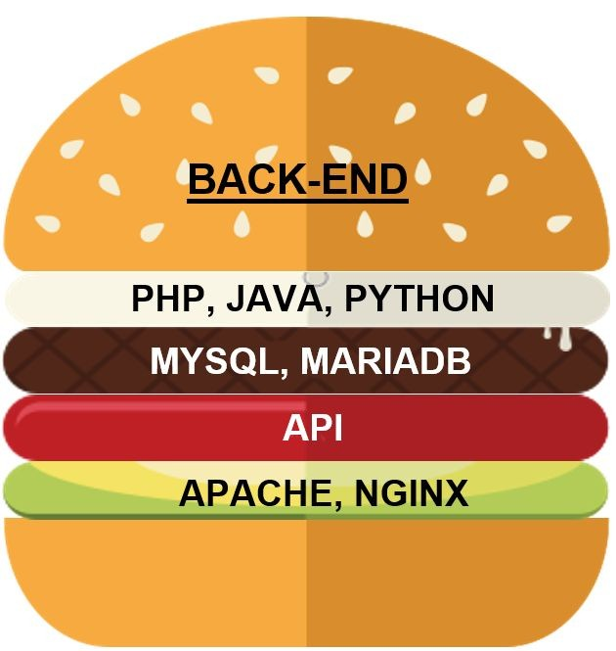
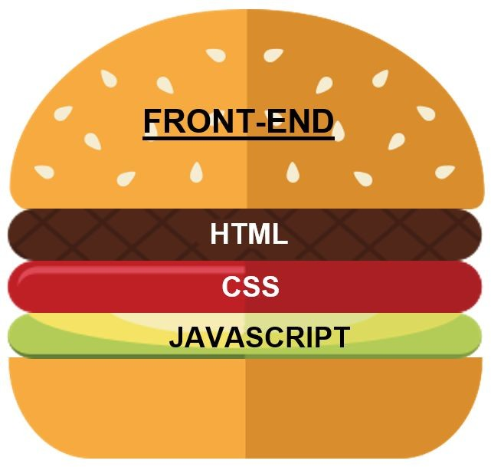
What is Web Development
3 BURGERS to DIGEST in WEB DEVELOPMENT

Slide 19
Front-end Developer
Back-end Developer

Slide 20
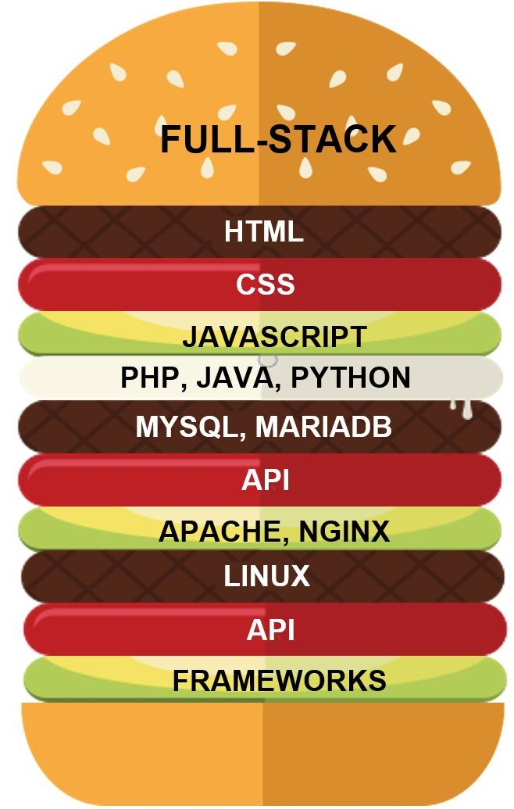

Slide 21
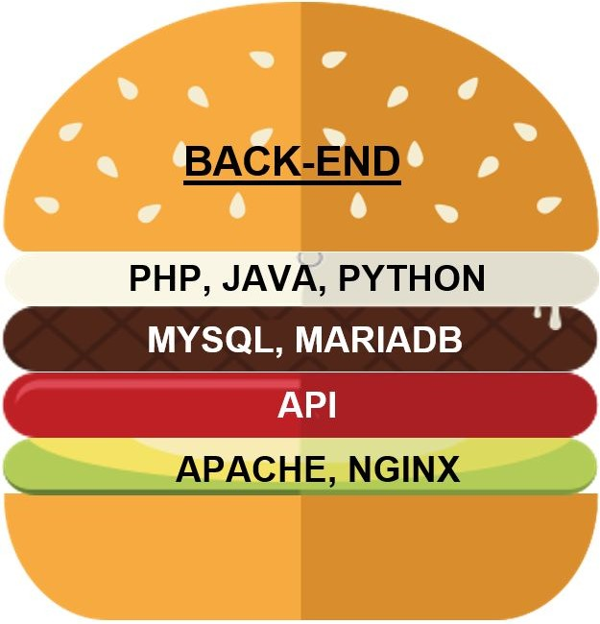
3 Web Stacks in 1 Course
Career path to become a Web Developer
Front-end Developer
Back-end Developer
Full-stack Developer

Slide 22
How To Become a Front-end Developer?

Slide 23
Front-end Development
Refers to everything that the end user experiences directly.
3 Core Front-end Web Technologies
HTML is a structure that holds the content of a page.
CSS is the styling and formatting of web pages.
Javascript is a scripting language to make a website responsive, dynamic and interactive.

Slide 24
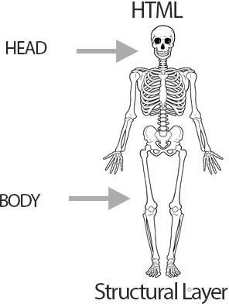
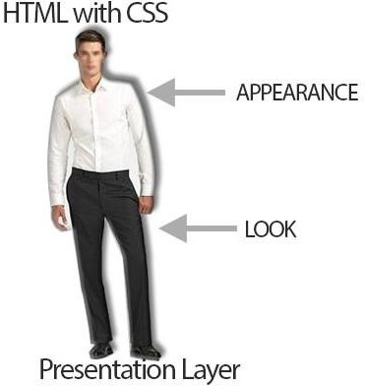
Understanding HTML and CSS
HTML builds web page structure
CSS enhances the look and style

Slide 25
HTML Overview
Hypertext Markup Language
Use of keywords or tag names
Enclosed within angle brackets < >
An opening tag is paired with a closing tag (but not all tags)
<tagname> content </tagname>
Some tags are self-closing or self-terminating (slash at the end is recommended)
<tagname />

Slide 26
Hypertext Markup Language
<html> …. </html>

Slide 27
Basic HTML Tags
Tag Name | Description
<html> </html> | HTML Tag is the parent tag or root element of a webpage.
<head> </head> | Head Tag is first child of html tag. Site page information for web browsers and Search engines.
<title> </title> | Title tag is used only once inside head tag. Title is always displayed in browsers tab.
<meta> | Meta tag is used to define the charset family, description, keywords, Author, robots and Geo Location of a website.
<body> </body> | Body tag is used to create the page structure or content. Structure includes Headings, Paragraphs, images, tables, division, etc of the website.

Slide 28
Basic Structure of an HTML Document
<!DOCTYPE html>
<html>
<head>
<title> My First HTML Page</title>
<meta charset="UTF-8">
</head>
<body>
Welcome to My First HTML page!
</body>
</html>
<!DOCTYPE>
<html>
<head>
<title>
<meta>
<body>

Slide 29
Exercise 1 : Create your first HTML
Follow these simple steps:

Slide 30
Basic Structure of an HTML Document
In Notepad type;
<!DOCTYPE html>

Slide 31
Basic Structure of an HTML Document
In Notepad type;
<!DOCTYPE html>
<html>
</html>

Slide 32
Basic Structure of an HTML Document
<!DOCTYPE html>
<html>
<head>
</head>
</html>

Slide 33
Basic Structure of an HTML Document
<!DOCTYPE html>
<html>
<head>
<title> My First HTML Page</title>
</head>
</html>

Slide 34
Basic Structure of an HTML Document
<!DOCTYPE html>
<html>
<head>
<title> My First HTML Page</title>
<meta charset="UTF-8">
</head>
</html>

Slide 35
Basic Structure of an HTML Document
<!DOCTYPE html>
<html>
<head>
<title> My First HTML Page</title>
<meta charset="UTF-8">
</head>
<body>
</body>
</html>

Slide 36
Basic Structure of an HTML Document
<!DOCTYPE html>
<html>
<head>
<title> My First HTML Page</title>
<meta charset="UTF-8">
</head>
<body>
Welcome to My First HTML page!
</body>
</html>

Slide 37
Exercise 1 : Create your first HTML
1.Save page as index.html file on your system.
2. Double click the file and your page is live on browser.
Present your first HTML page!

Slide 38
Basic HTML Tags
Tag Name | Use
<h1> </h1> | A section heading level 1. Headings are up to <h6> </h6>
<p> </p> | A paragraph tag
<a> </a> | Hyperlink, formerly anchor tag
<img> | An image tag
<br> | Line break
<b> </b> | Bold text
<div> </div> | Division, a block-level element for grouping
<span> </span> | An inline level grouping element
<!-- --> | Insert comment in the source code. A short description of code. Not displayed in the browser.

Slide 39
HTML Attributes
Provides additional information about the html tags or elements
Two parts of attribute: attribute name and attribute value
HTML TAG
HTML ATTRIBUTES
Name Value
Name Value
<img src="picture.png" alt="picture">

Slide 40
HTML Attributes
Attribute Name | Description
href | Hypertext Reference specifies the url (web address) for a link. <a href="about.html">About</a>
src | Source of media elements like images, iframes, Audio, Video. <img src="logo.png">
id | Set unique id of single element <h1 id=“MyHeader"> My First HTML Page </h1>
class | Group single or multiple elements. <p class=“intro">This is an Introduction</p>
style | Specifies an inline style for an element <p style="color:green">This is color green paragraph.</p>
alt | Specifies an alternative text. <img src="logo.png" alt=“Company Logo“ >
title | Tooltip of an element. <img src="logo.png" title=“This is Company logo”>

Slide 41
Activity 1 : Create an HTML File
Follow these simple steps:
Open a text editor, e.g. Notepad
Type the following text :
My First HTML page.
Save the file as index.html
Double click the file and your page is live on browser
Add the following text to the page:
Welcome to My First HTML page! I am { write your name}.
My passions are { write 3 passions/interests }.
Save the file
Discuss what your page look like.

Slide 42
Exercise 1.a: Create Your First HTML page with Tags and Attributes
Continue with your first html page.
Add the HTML tags and attributes.
Save the file
Refresh the page on your browser
Discuss the difference

Slide 43
Basic Structure of an HTML Document
In Notepad/Text edit (previous activity)
<!DOCTYPE html>
<html>
<head>
<title> My First HTML Page</title>
<meta charset="UTF-8">
</head>
<body>
Welcome to My First HTML page!
</body>
</html>

Slide 44
HTML Tags and Attributes
<!DOCTYPE html>
<html>
<head>
<title>My First HTML Page</title>
<meta charset="UTF-8">
</head>
<body>
<h1 style="color:blue; text-align:center;"> Welcome to My First HTML page! </h1>
</body>
</html>

Slide 45
HTML Tags and Attributes
<!DOCTYPE html>
<html>
<head>
<title>My First HTML Page</title>
<meta charset="UTF-8">
</head>
<body>
<h1 style="color:blue; text-align:center;"> Welcome to My First HTML page </h1>
<p style=“color:green”> I am ….</p>
</body>
</html>

Slide 46
HTML Tags and Attributes
<!DOCTYPE html>
<html>
<head>
<title>My First HTML Page</title>
<meta charset="UTF-8">
</head>
<body>
<h1 style="color:blue; text-align:center;"> Welcome to My First HTML page </h1>
<p style=“color:green”> I am ….</p>
<p style=“color:red”> My passions are …. </p>
<img src=“myphoto.png” alt=“Profile Photo”> <br/>
</body>
</html>

Slide 47
HTML Tags and Attributes
<!DOCTYPE html>
<html>
<head>
<title>My First HTML Page</title>
<meta charset="UTF-8">
</head>
<body>
<h1 style="color:blue; text-align:center;"> Welcome to My First HTML page </h1>
<p style=“color:green”> I am ….</p>
<p style=“color:red”> My passions are …. </p>
<img src=“myphoto.png” alt=“Profile Photo”> <br/>
<a href=“Actitivy2_html.html”> This is my second webpage. </a>
</body>
</html>

Slide 48
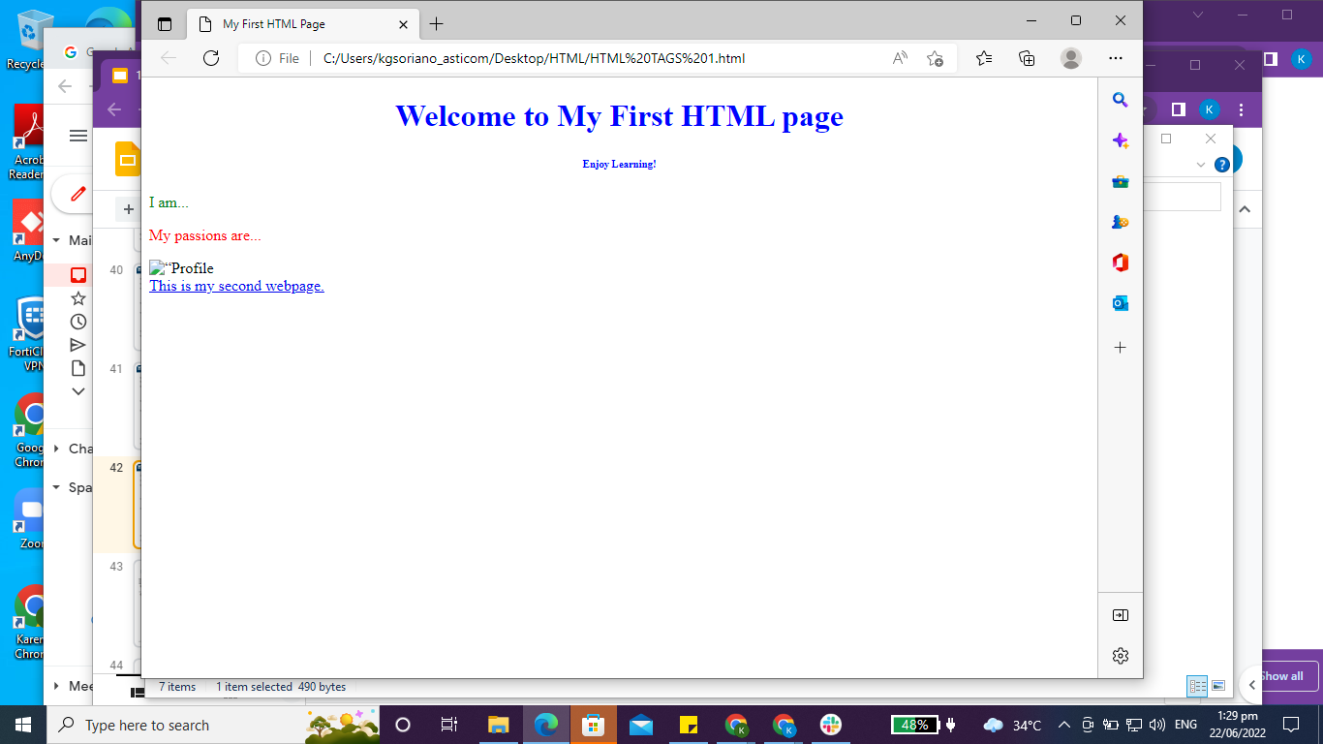

Slide 49
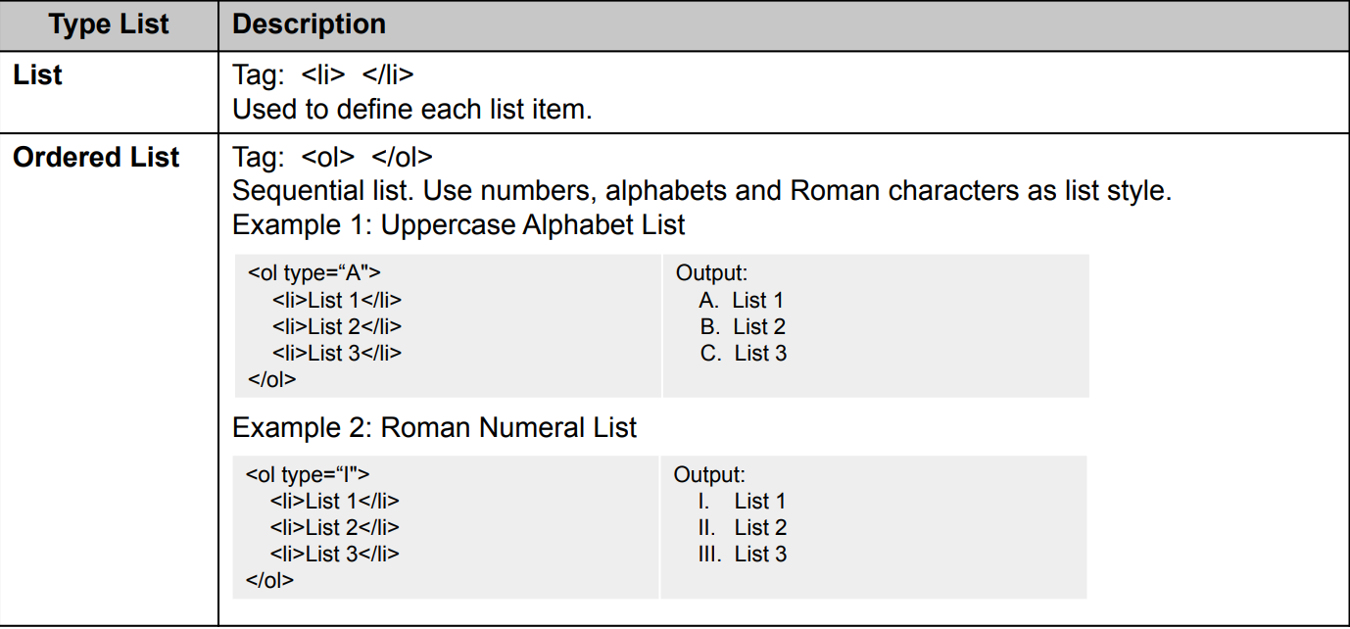
HTML List Tag

Slide 50
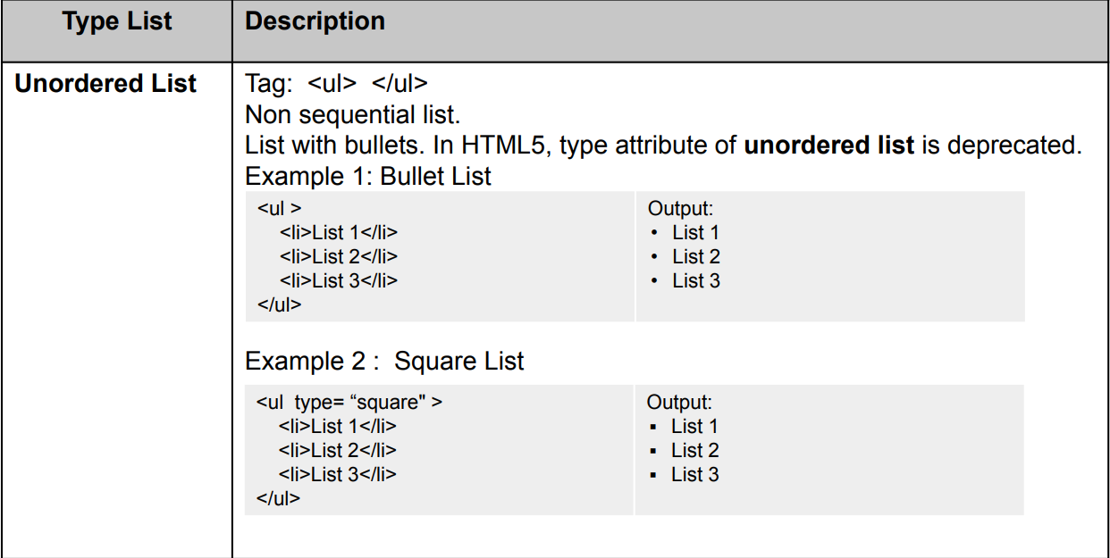
HTML List Tag

Slide 51
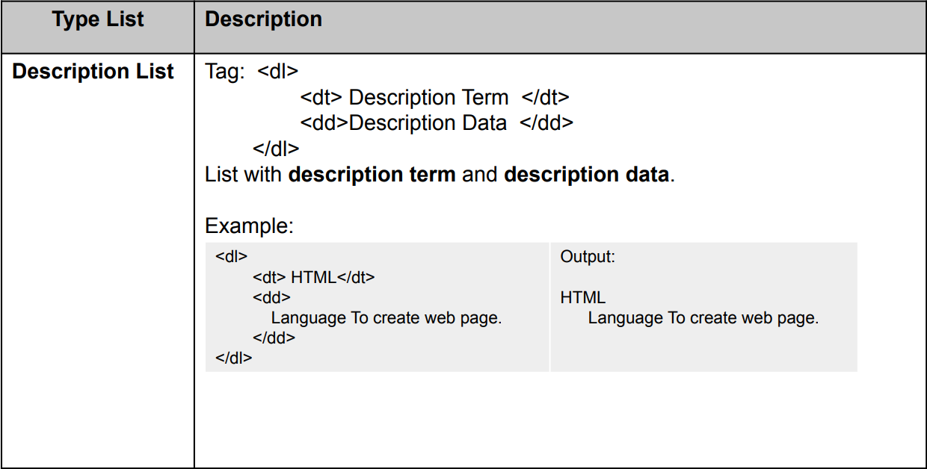
HTML List Tag

Slide 52
Exercise 2: Re-create The World’s First Website
Create a new html file name
Apply what you have learned today, about HTML tags and attributes.
Save page as firstwebsite.html file on your system.
Double click the file and your page is live on browser.
Present your version of World’s First Website!

Slide 53
The World’s First Website
Source: http://info.cern.ch/hypertext/WWW/TheProject.html

Slide 54
HTML Reference
https://www.w3schools.com/html/default.asp
https://developer.mozilla.org/en-US/docs/Learn/HTML

Slide 55
Learning Outcomes
What have you learned today?
Technical Skills
Introduction to Web Development
Introduction to Web Stacks
HTML Tags
HTML Attributes
Soft Skills
Communication Skill
Research
Problem-solving

Slide 56
Day 1 Wrap Up
Soft Skills
Communication Skills
Research
Problem-solving
Technical Skills
Introduction to Web Development
Introduction to Web Stacks
HTML Tags
HTML Attributes
Enjoy Learning!

Slide 57
Thank you!

